Slide 1
Pager Rotation in DevOps
Cody Ferre
09/20/2024
CSD380-O302

Slide 2
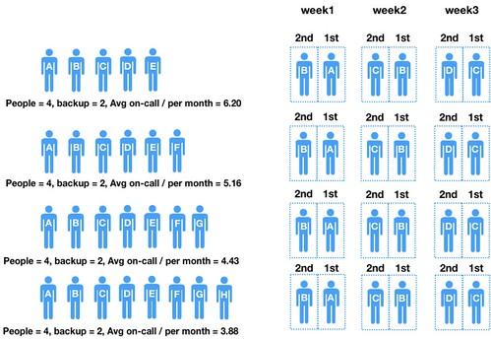
Pager Rotation
The Pager Rotation is made up of developers, architects, and the managers.
Being used to ensure that problems and errors are fixed in a quick manner.
This is all because everyone within the value stream shares the downstream of handling the operational incidents.

Slide 3
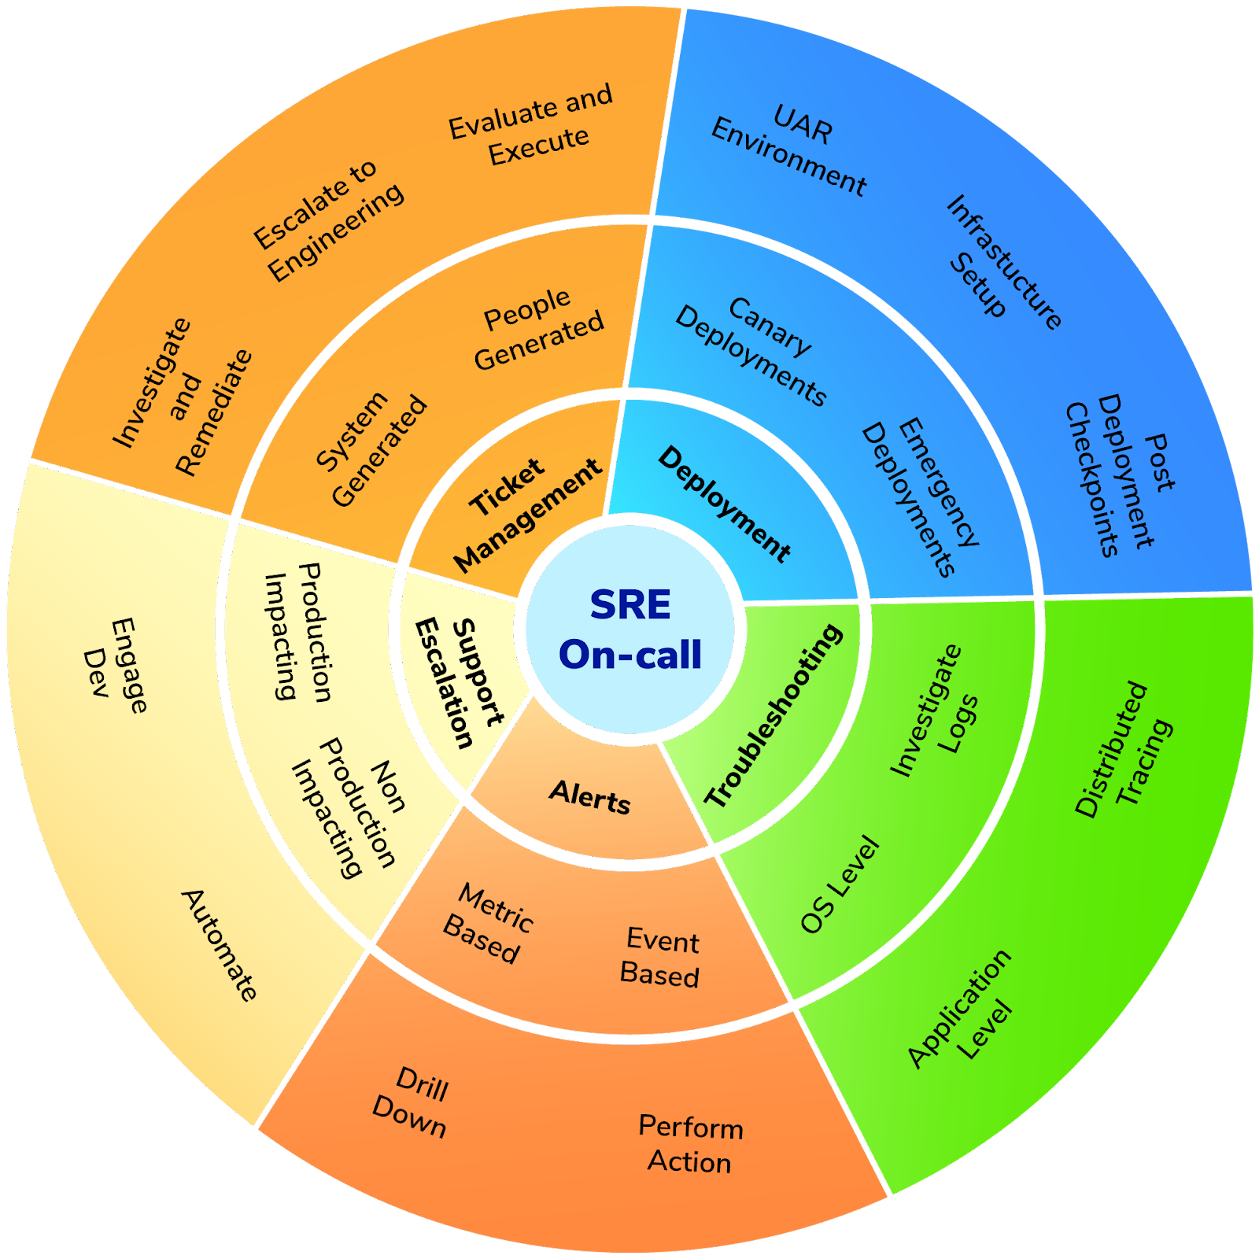
On-Call Rotation
Creating Teams that are able to handle the issues that arise within the hours out of business time.
Define a way to escalate problems if needed to ensure that they can still be handled within the team.
Ensure that there is always coverage for the on-call shift but also to establish backups if needed.

Slide 4
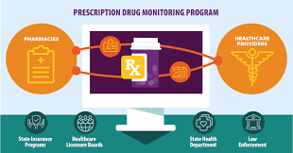
Monitoring Efficiently
Making use of monitoring programs to help keep up to date on all issues that do arise within the program.
This includes monitoring the metrics of people who are on-call, to move people based on needs.
Effective accountability and transparency on issues allow for the team to properly keep everyone reliable.

Slide 5
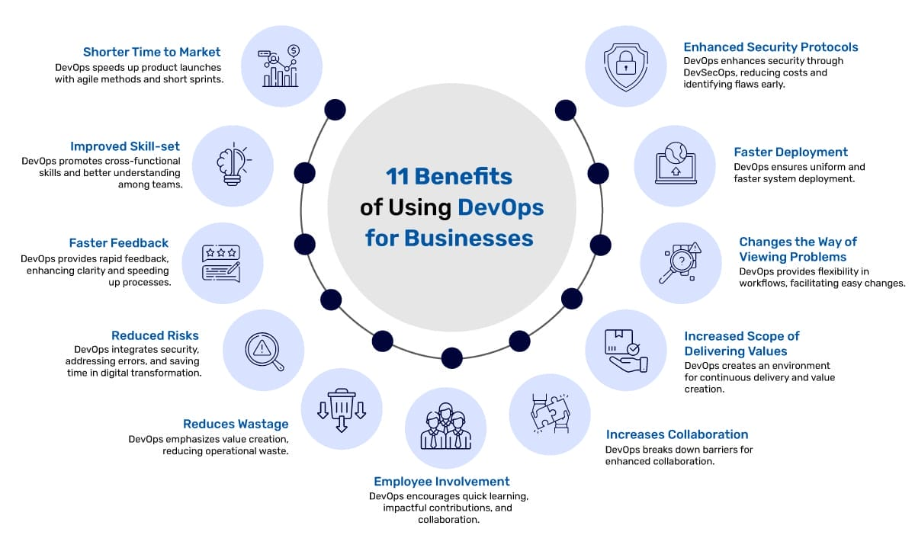
Why Rotating is Important

Slide 6
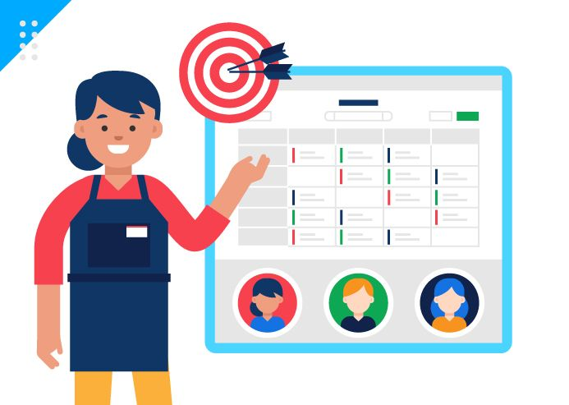
Outcome of the rotation
Leads towards more satisfied customers and a better well-rounded employees working within teams.
Increased coverage allows for fewer downtimes and better reliability.
Allows for faster responses to emergency's that could escalate if not.

Slide 7
Citations
2023, Best Practices for managing on-call, cortex, https://www.cortex.io/post/best-practices-for-on-call-rotations
2024, On-Call Rotations and Schedule, pager, https://www.pagerduty.com/resources/learn/call-rotations-schedules/
2024, Best Practices for your team's on call rotations, alertops, https://alertops.com/on-call-rotation/

